Slide 1



Slide 2


Slide 3

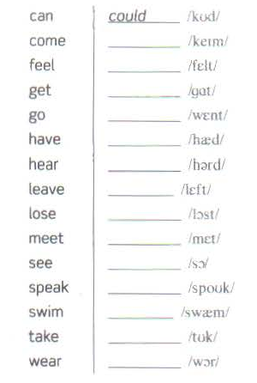
came
felt
got
went
had
heard
left
lost
met
saw
spoke
swam
took
wore

Slide 4


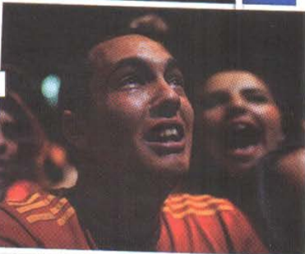

Slide 5


Slide 6
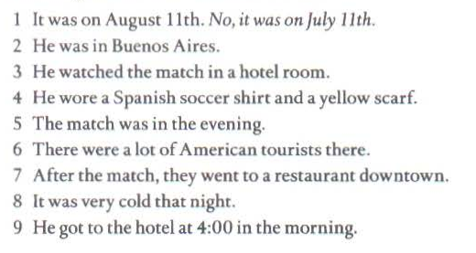

Slide 7


SDFGDGD
XZDVCDFBF
FBHFGJHFG

Slide 8

SDFDG
SDFDG
SDFDG

Slide 9

SDFGDFG
SDFGDFG
SDFGDFG

Slide 10


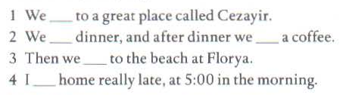
went
had
had
went
got

Slide 11



Slide 12
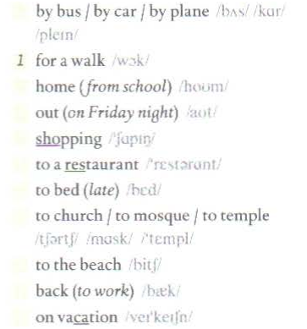
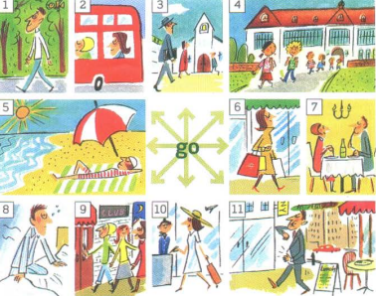
2
4
9
6
7
8
3
5
11
10

Slide 13
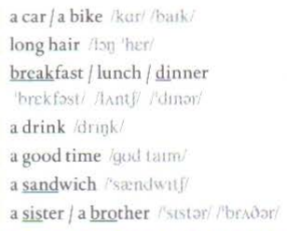
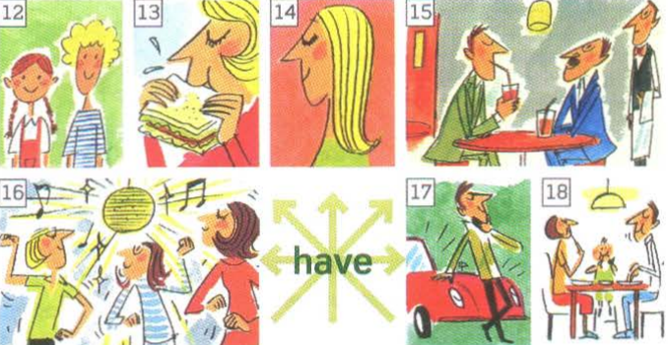
17
14
18
15
16
13
12

Slide 14
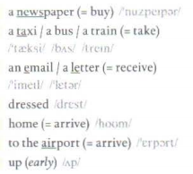
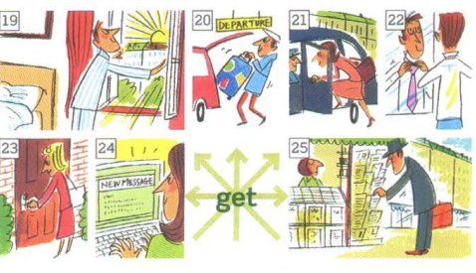
25
21
24
22
23
20
19

Slide 15

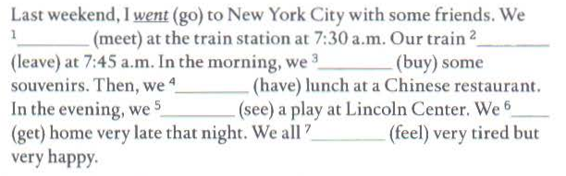
met
left
bought
had
saw
got
felt

Slide 16
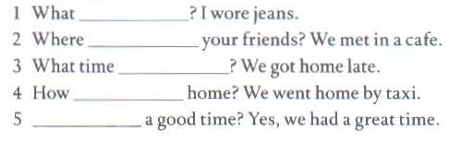

Slide 17



did you wear
did you meet
did you get home

Slide 18

did you go
Did you have

Slide 19

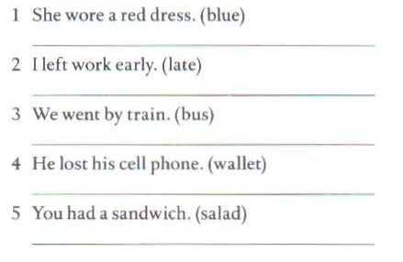
She wore a blue dress.
I left work late.
We went by bus.
He lost his wallet.
You had a salad.

Slide 20
6. SPEAKING and WRITING
ANSWER THE QUESTIONS

Slide 21
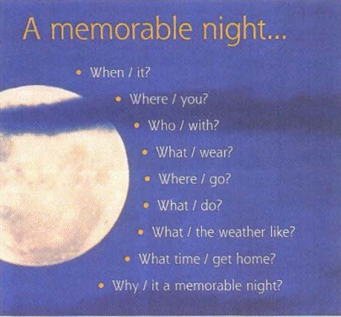

Slide 22
QUESTIONS
1. When was it ?
2. Where were you ?
3. Who did you go with ?
4. What did you wear ?
5. Where did you go ?

Slide 23
QUESTIONS
6. What did you do ?
7. What was the weather like ?
8. What time did you get home ?
9. Why was it a memorable night ?

Slide 24


Slide 25

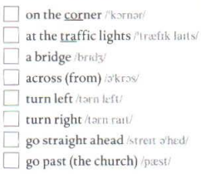
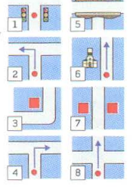
3
1
5
7
2
4
8
6

Slide 26
HOMEWORK
- Learn vocabulary by hearth.
- Prepare next lessons.

Slide 27

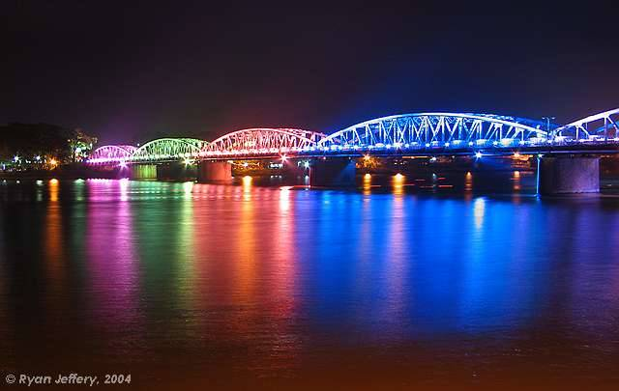


Thank you for your attention!

